Slide 1
Status Update: Model Hand Pose Prediction
By Johnbright Anyaibe, Shenoda Ghobryal, Tiffany Gonzalez H Bohorquez, Sheida Mazloom, Paula Restrepo Clavijo, Jennifer Tran

Slide 2
Outline
Project Description
Hardware & Software
Testing
Limitations

Slide 3
Project Description
Produce a working prototype and working dataset for the vowels of the American sign language such that a machine learning system can be used to evaluate whether the hand motion is accurate.

Slide 4
Current Software & Hardware Capabilities

Slide 5
Software
Paula
Notes:
We were between utilizing matlab and python but due to ease of accessibility and cost effectiveness we decided to move with python.

Slide 6
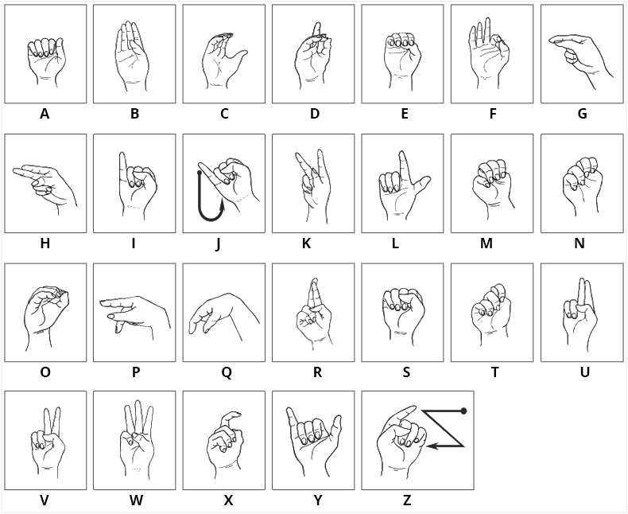
Python - Paula
Goal: Create a database that will be the “Golden Standard” for each of our identifiers
Currently working on “a”
Challenge:
Large data load
Takes a long time
Crashes computer
(TensorFlow, 2022)
Notes:
After speaking with the PI I decided to further research keras and tensorflow for image processing/ database development
In an example that I found, input data (AKA images) was read from local machine and with no preprocessing. In this study, they found that :tensorflow’s tf.data has a more efficient input pipeline and avoid bottlenecks when comparing to Keras ImageDataGenerator. There was a case where I saw that tf.data out performed 2x faster than Keras ImageDataGenerator.
After seeing this I discussed with some team members and I decided to move forward with tensorflow…

Slide 7
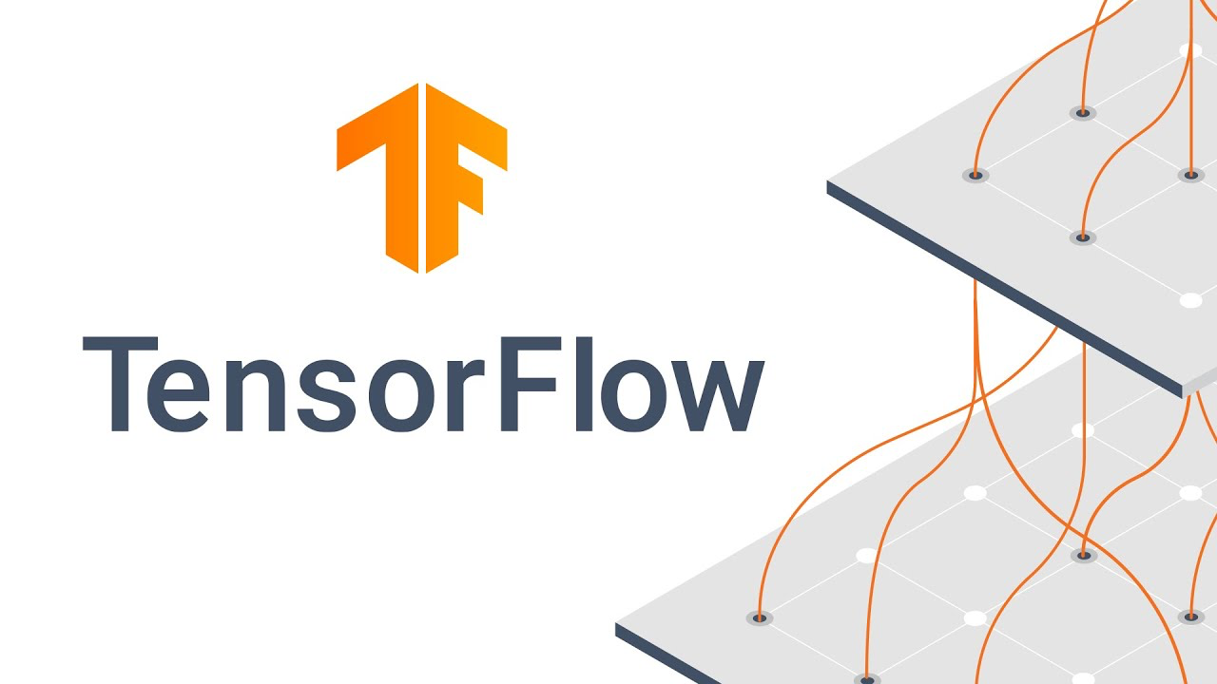
TensorFlow: TensorFlow Input Pipeline
Benefits:
Can handle large datasets by the streaming approach
Model training by batches
Can apply transformations to make dataset ready for model training
Utilize the tf.data API framework
Utilize tf.data.Dataset as the main class in the framework
Other classes will be the identifiers
(TensorFlow, 2022)
Notes:
Other classes will be the vowels of the american sign language a, e, i, o, u.

Slide 8
TensorFlow Input Pipeline - Paula
Load images from identifier folder (ex. sign_language_a)
Train the model
ex: model.fit(tf.dataset)
tf.dataset Creation
Convert image content to numpy array/ extract label from label folder
Scale (normalize the data)
(TensorFlow, 2022)
Notes:
Moving forward we want to see if we can use this database to overlay it with that of live images to determine accuracy. The output of these live images would be in a csv file and be considered the test database and then be cross referenced with that of our trained database.

Slide 9
Hand Gesture Recognition - Tiffany
extract data from live hand gesture
Read in Created Model (ex. sign_language_a-z)
Output Prediction
Predict the motions
(TensorFlow, 2022)

Slide 10

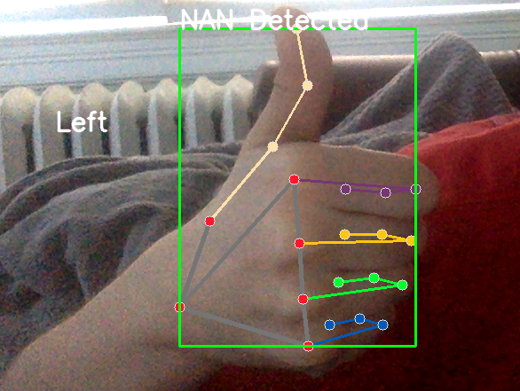
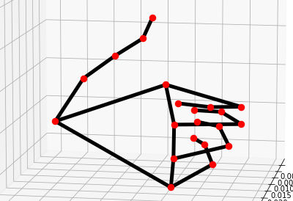



Initial Testing
With minor processing the camera averages around 10 Hz
More processing the camera averages around 5-7 Hz
With modeling the camera averages around 1 Hz

Slide 11
Hardware
Tiffany

Slide 12
Limitations - No External Funding
Computer Limitations
Computer capability is limited to a laptop
Data Space limitations
Processing limitations
Graphics limitations
Camera Limitations
Light limited
Limited data collection
Lower Accuracy due to camera quality

Slide 13
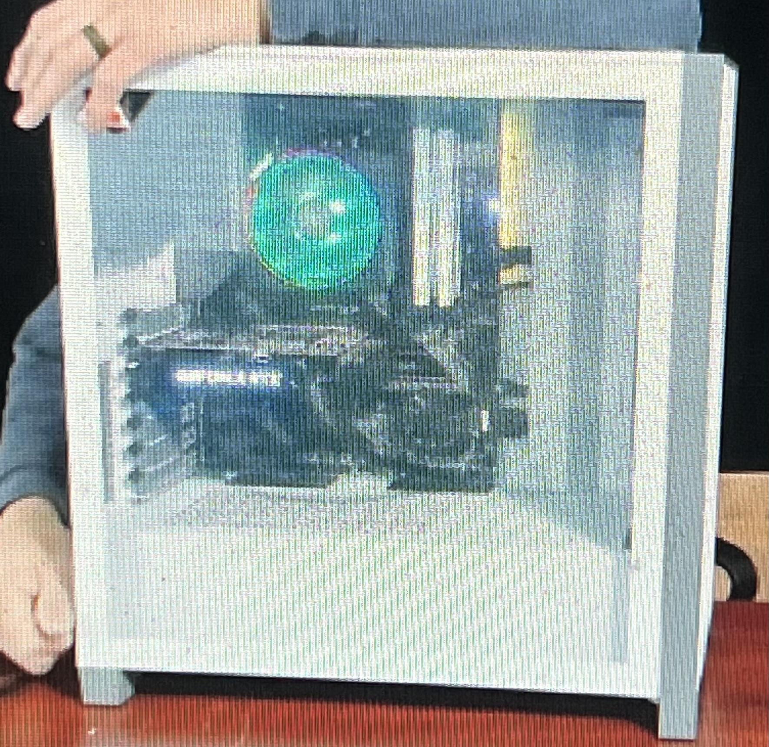
Processing Computer Option
I bought a computer prior to the class with better processing capabilities to program in 3D environments for AR, VR, and MR
Delivery: yesterday
Benefits:
Better processing capabilities
Windows OS so would provide cross compatibility testing capabilities

Slide 14
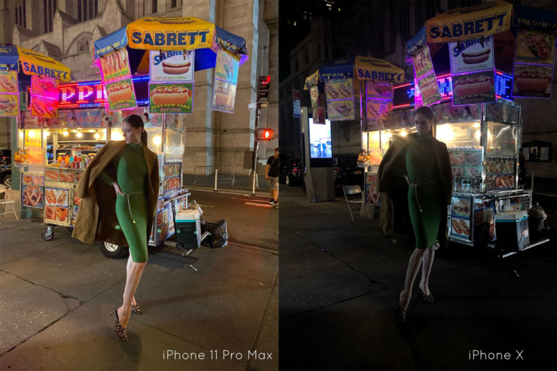
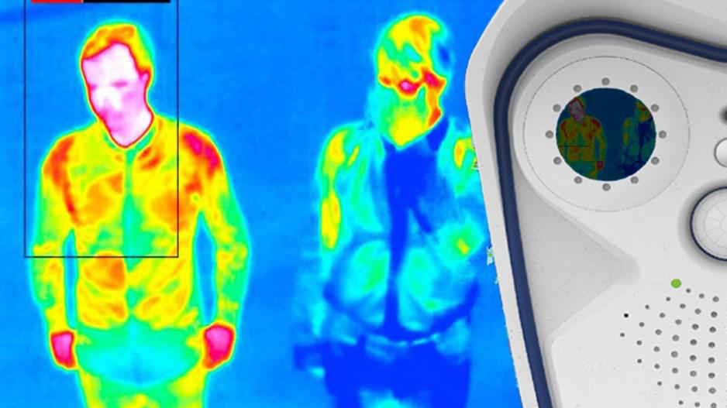
Camera Options
One of the limitations found was using the basic webcam:
Increase model accuracy
Cameras with low light or thermal capabilities
Better Specs

Slide 15
Camera Calibration &
Optimization
Sheida

Slide 16
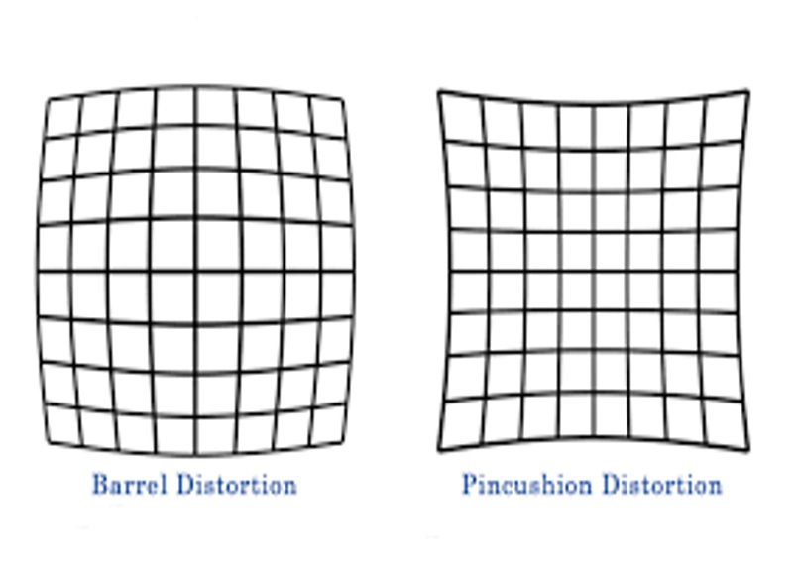
Camera calibration
Goal:
To determine the intrinsic and extrinsic parameters
of a camera and remove camera distortions.
Prerequisite
Python
OpenCV
NumPy
Challenges
Instrumental capacity
Time limitation
Coding skill
(Python Wife, 2021)

Slide 17
Camera Calibration Steps
Use a known object of known size (Chessboard)
Capture the image of chessboard at different positions
Find camera parameters by OpenCV
Remove distortions
(Kaustubh Sadekar Satya Mallick, 2021)

Slide 18
Camera optimization:
A process that used to improve quality of live images.​
Improving Camera Quality by (Trinh,2020):​
Use an external webcam​
Adjust the camera setting​
Adjust the light and background​
Use a PC with enough free space
Use image optimizer software

Slide 19
Eliminating Environmental Distortions (John)

Slide 20
Problems/Solutions
Problem:
With the use of a camera for tracking there is always the possibility of picking up the wrong Images.
Solutions:
Watershed Algorithm
Palm Detection Models

Slide 21
Watershed Algorithm
Watershed is an image segmentation technique widely used. Many researchers This method has been utilized by various researchers and implemented in open source libraries without a deep understanding of its characteristics and limitations. In the review, we describe benchmarking outcomes of six open-source marker-controlled watershed implementations for the segmentation of 2D and 3D images.
(Kornilov, 2018)

Slide 22
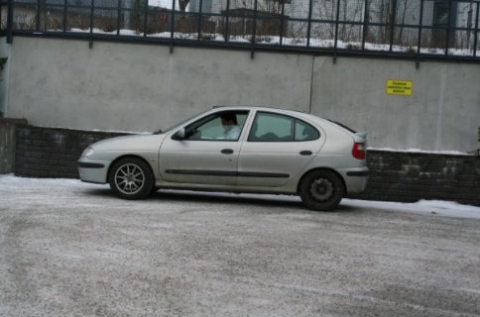
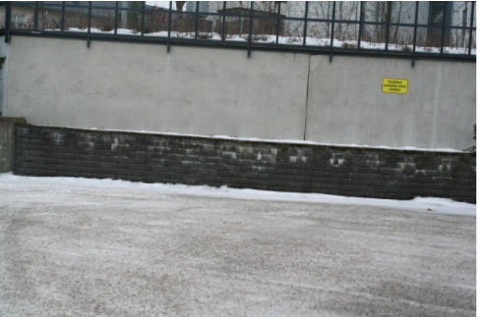
Application of Watershed Algorithm
Select various “seed” markers to indicate where an image is
Using the watershed algorithm set 1st input as the image and the second input as the marker location
Problems:
Can take a long time to select markers for every image
Tools needed for pixel coordinates

Slide 23
Palm Detection Model
Works similarly to face tracking models. The models are complex in contrast due to the fact that there are not as many recognizable features such as eyes, mouths etc.

Slide 24
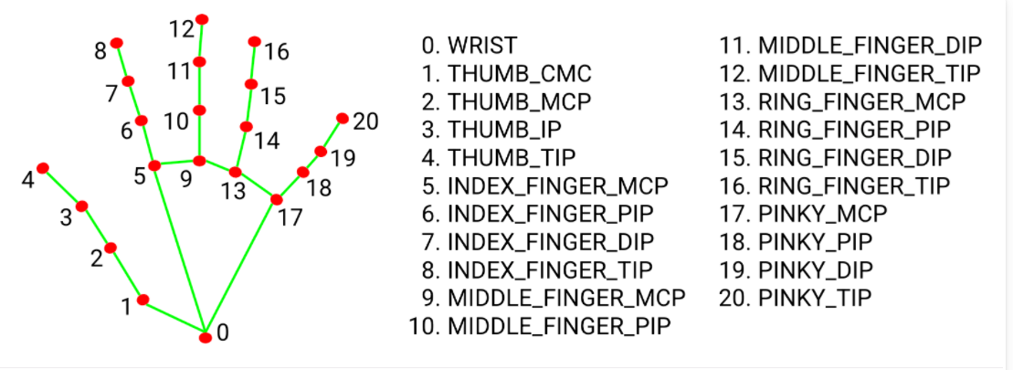
Application of Palm Detection Model
Uses square bounded boxes (or anchors) to model palms.
Encoder Decoder Feature used for context awareness
High scale of variance achieved through the use of focal loss minimization
Leads to 95.7% accuracy (MediaPipe 2021)
Upside:
Less time consuming
More Accurate than watershed method.
(MediaPipe, 2021)

Slide 25
Analysis
Jennifer

Slide 26
Principal Component Analysis (PCA)
Used to interpret data by simplifying the data but also maintains the data trends and patterns through linear combinations
Transform data into fewer dimensions
Reduces data by geometrically projecting them onto lower principal components (PCs)
First PC - minimize total distance between data and projection into PC
Subsequent PCs - uncorrelated with previous PCs
(Lever et al., 2017)

Slide 27
Data Normalization
Ensures data have similar distributions which will improve model accuracy
Rescales data to ensure that all values are within the range of 0 and 1
Equal weights/importance to each variable
Three different methods
Rescaling
Mean normalization
Z-score normalization
StandardScaler() function
Normalize the features of each column of the data individually so that the data will have a mean value of 0 and standard deviation of 1
(Alam, 2020)

Slide 28
Accuracy Analysis
Classification accuracy refers to accuracy in that it is the ratio of number of correct predictions to the total number of input samples
False sense of achieving high accuracy
Logarithmic Loss - penalizes false classifications
Confusion Matrix - outputs a matrix and describes the complete performance of the model
Accuracy calculated by taking average of the values lying across “main diagonal”
Area Under Curve - used for binary classification problem
F1 Score - measure a test’s accuracy
Harmonic Mean between precision and recall
(Mishra, 2020)

Slide 29
Similar projects &
Research questions.
Shenoda

Slide 30
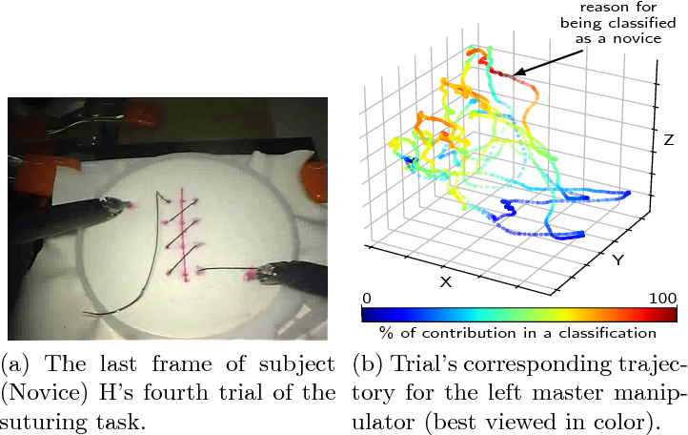
Similar projects
There are many research projects that had similar goals but used different methodology
Accurate and interpretable evaluation of surgical skills from kinematic data using fully convolutional neural networks (Ismail Fawaz et al., 2019)
Main differences and similarities to our project
The visualization function with 3d heat maps can be a useful addition to our project if feasible
(Ismail Fawaz et al., 2019)

Slide 31
Similar projects (cont.)
Evaluation of Surgical Skills during Robotic Surgery by Deep Learning-Based Multiple Surgical Instrument Tracking in Training and Actual Operations (Lee et al., 2020).
Who's better? Who's best? Pairwise deep ranking for skill determination (Doughty et al., 2018).
(Doughty et al., 2018)
(Lee et al, 2020)

Slide 32
More questions to answer
Using visual classification through 3d CNN deep learning with raw video or image data inputs. How will that be compared to our model that uses kinematic data as inputs in terms of prediction accuracy and computational cost?

Slide 33
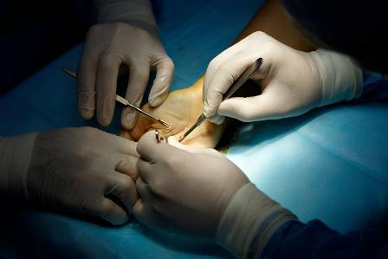
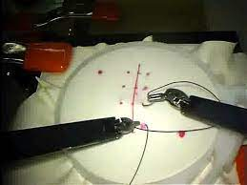
2. Can our model work to compare the kinematic data of hand gestures to kinematic data from other objects like endoscopic tools as in JIGSAWS dataset?
(Gao et al., 2014)

Slide 34
3. How can simple changes in visual inputs (examples are mirroring of left-handed gestures or using grayscale videos instead of RGB videos) affect the performance of the model?

Slide 35
References
Alam, M. (2020, December 14). Data normalization in machine learning. Medium. Retrieved February 13, 2022, from https://towardsdatascience.com/data-normalization-in-machine-learning-395fdec69d02
Doughty, H., Damen, D., & Mayol-Cuevas, W. (2018). Who's better? who's best? pairwise deep ranking for skill determination. Proceedings of the IEEE Conference on Computer Vision and Pattern Recognition, 6057-6066. Retrieved from https://openaccess.thecvf.com/content_cvpr_2018/papers/Doughty_Whos_Better_Whos_CVPR_2018_paper.pdf
Gao Y., Vedula S., Reiley C. E, Ahmidi N., Varadarajan B., Lin H. C., Tao L., Zappella L. , B ́ejar B. , Yuh D. D., Chen C., Vidal R., Khudanpur S. & Hager G.D. (2014). Thee JHU-ISI Gesture and Skill Assessment Working Set (JIGSAWS): A surgical activity dataset for human motion modeling. Modeling and Monitoring of Computer Assisted Interventions (M2CAI) – MICCAI Workshop. Retrieved from https://cirl.lcsr.jhu.edu/research/hmm/datasets/jigsaws_release/
Ismail Fawaz, H., Forestier, G., Weber, J. et al.(2019) Accurate and interpretable evaluation of surgical skills from kinematic data using fully convolutional neural networks. Int J CARS 14, 1611–1617 . https://doi.org/10.1007/s11548-019-02039-4
Kaustubh Sadekar Satya Mallick, Sadekar, K., & Mallick, S. (2021, May 04). Camera calibration using opencv.https://learnopencv.com/camera-calibration-using-opencv/
Lee, D., Yu, H. W., Kwon, H., Kong, H.-J., Lee, K. E., & Kim, H. C. (2020). Evaluation of Surgical Skills during Robotic Surgery by Deep Learning-Based Multiple Surgical Instrument Tracking in Training and Actual Operations. Journal of Clinical Medicine, 9(6), 1964. MDPI AG. Retrieved from http://dx.doi.org/10.3390/jcm9061964
Lever, J., Krzywinski, M., & Altman, N. (2017, June 29). Principal component analysis. Nature News. Retrieved February 13, 2022, from https://www.nature.com/articles/nmeth.4346
Mishra, A. (2020, May 28). Metrics to evaluate your machine learning algorithm. Medium. Retrieved February 13, 2022, from https://towardsdatascience.com/metrics-to-evaluate-your-machine-learning-algorithm-f10ba6e38234
Python Wife.(2021, December 7). Camera calibration in python with opencv. https://pythonwife.com/camera-calibration-in-python-with-opencv/
TensorFlow. (2022, February 4). Tf.data: Build tensorflow input pipelines : Tensorflow Core. TensorFlow. Retrieved February 11, 2022, from https://www.tensorflow.org/guide/data
Trinh, K., Lisa, Jim, & Jennifer. (2020, December 30). How to improve laptop camera quality (in 2 minutes). https://www.netbooknews.com/tips/how-to-improve-laptop-camera-quality/#:~:text=8%20Things%20You%20Can%20Do%20To%20Improve%20Laptop,laptop%20camera%20video%20settings.%20...%20More%20items...%20

